Slide 1

ICMP Ping Client
Huang Hao, Zhou Yitong, Meng Yu, Chen Zijie, Wen Tianshu
2024.10.11

Slide 2
Introduction of ICMP
01 Preparation
Divide of tasks
02 Packet
CONTENTS
Send & Receive & delay calculation
03 Process
ICMP Type Handling
do one ping & ping
04 Test
Visualization
05 Conclusion
Version control

Slide 3
01
PART
Preparation

Slide 4






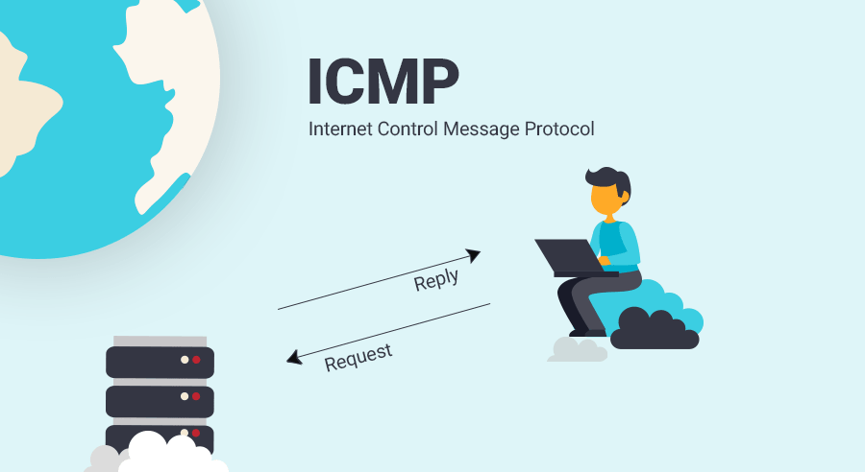
Prepare
Packet
process
test
conclusion
Introduction of ICMP
when the network packets transmittion problems are encountered, messages are
sent out to report the error, so that the
transmission strategy can be adjusted.

Slide 5
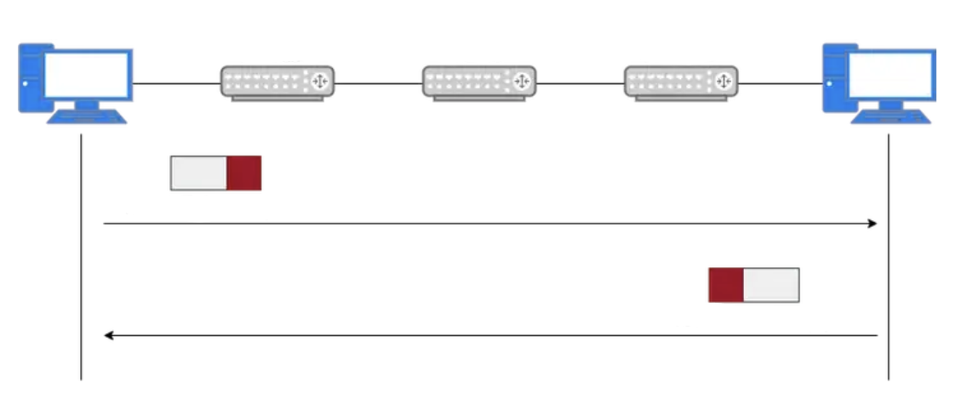
Prepare
Packet
process
test
conclusion
Introduction of ICMP
create icmp packet
ping multiple addresses
send one ping
extra
checksum
------
ping
---
do one ping
animate (Real-time plotting)
functions
receive one ping
checksum
traceroute
Host A
Router A
Router B
Router C
Host B
id(unique)
Header
……
ICMP Echo Request
ICMP data packet
Socket
Data
Delay
ICMP Echo Reply

Slide 6
Prepare
Packet
process
test
conclusion
Division of tasks
Huang Hao
Getting through the code framework
Concurrency control & RTT visualization
Windows & Linux testing
Meng Yu
Checksum calculation
ICMP packet management
Customize user input
Chen Zijie
send & receive function
delay calculation(min/max/avg)
Exception Handling Improvement
Zhou Yitong(presentor)
do one ping & ping
ICMP socket management
multi-threaded processing
Wen Tianshu
Functional testing with wireshark
Calculation of packet loss rate

Slide 7
02
PART
Packet construction

Slide 8


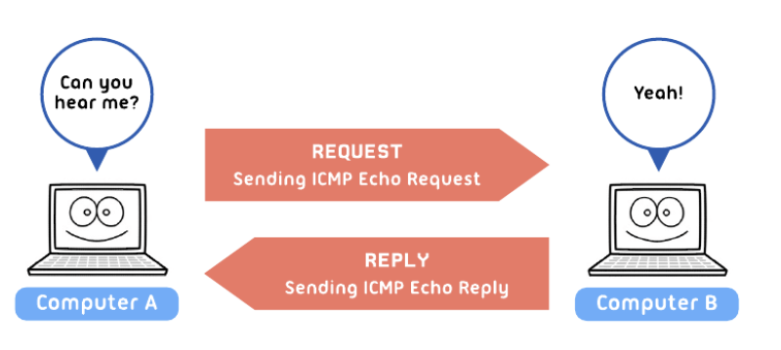
Prepare
Packet
process
test
conclusion
ICMP Packet Construction and Validation Process
Host A
Router A
Router B
Router C
Host B
calculate_checksum Function
PC A
1. Calculates the checksum for an ICMP packet (used to verify data integrity).
2. Processes the data in 16-bit blocks (two bytes) and sums them up.
3. If the data length is odd, it pads with a zero byte for checksum calculation.
4. Carries any overflow bits from the most significant to the least significant.
5. Returns the one's complement of the sum (inverted bits), which becomes the packet's checksum for error checking.
ICMP Echo Request
ICMP Echo Reply
create_icmp_packet Function
1. Creates an ICMP packet to be sent in an Echo Request.
2. Assembles the ICMP header fields: type (8 for request), code (0), checksum (initially 0), packet ID, and sequence number.
3. Packs the header using struct.pack to convert the values into a binary format for transmission.
4. Calls calculate_checksum to compute the checksum over the combined header and user data.
5. Replaces the initial checksum with the correct value in the packed header.
6. Combines the header and user data into a complete packet.
7. Returns the full ICMP packet ready to be sent.
点击此处修改内容点击此处修改内容点击此处修改内容点击此处修改内容改内容

Slide 9
Prepare
Packet
process
test
conclusion
ICMP structure
create icmp packet
ping multiple addresses
send one ping
extra
checksum
------
ping
---
do one ping
animate (Real-time plotting)
functions
receive one ping
checksum
traceroute
Host A
Router A
Router B
Router C
Host B
id(unique)
Header
……
ICMP Echo Request
ICMP data packet
Socket
Data
Delay
ICMP Echo Reply

Slide 10
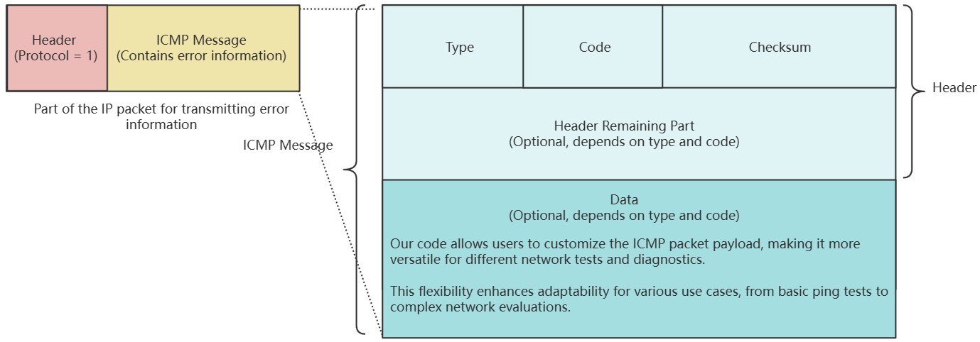



Prepare
Packet
process
test
conclusion
ICMP Packet Composition
1. The packet consists of two main parts: the header and the data.
2. The header includes essential control information like Type, Code, Checksum, Packet ID, and Sequence Number.
3. The data section contains user-defined data, often used for diagnostic purposes like timestamps or padding.
bbHHh Explanation
Header & Data
b: 1 byte for the Type field (e.g., Echo Request or Echo Reply).
b: 1 byte for the Code field (specifies the subtype of the ICMP message).
H: 2 bytes for the Checksum (used for error checking).
H: 2 bytes for the Packet ID (to match requests with replies).
h: 2 bytes for the Sequence Number (helps track packet order).
1. The header stores the control and identification information required for ICMP communication (Type, Code, Checksum, Packet ID, Sequence Number).
2. The data section holds additional information, such as timestamps or any other diagnostic data needed for the echo request and reply process.

Slide 11
03
PART
Process of ICMP

Slide 12

prepare
packet
process
test
conclusion
ICMP Transmission Process
send_one_ping Function
1. Sends an ICMP Echo Request packet.
2. Uses the created socket, target IP address, packet ID, and user data.
3. Creates an ICMP packet with create_icmp_packet containing ICMP header and user data.
4. Records the sending timestamp to calculate round-trip time later.
5. Sends the packet using sendto; port is set to 1 since ICMP does not use traditional ports.
6. Returns the timestamp for further processing.
SOCKET
receive_one_ping Function
点击此处修改内容点击此处修改内容点击此处修改内容点击此处修改内容改内容
1. Receives the ICMP Echo Reply packet and calculates round-trip time.
2. Sets socket timeout to avoid indefinite waiting.
3. Validates packet length to ensure it contains both IP and ICMP headers.
4. Parses ICMP header fields (type, code, checksum, ID, sequence number).
5. Confirms the packet type as Echo Reply and matches ID to verify it's the correct response.
6. Verifies the consistency of user data and returns the round-trip time.

Slide 13
prepare
packet
process
test
conclusion
Introduction of ICMP
create icmp packet
ping multiple addresses
send one ping
extra
checksum
------
ping
---
do one ping
animate (Real-time plotting)
functions
receive one ping
checksum
traceroute
Host A
Router A
Router B
Router C
Host B
id(unique)
Header
……
ICMP Echo Request
ICMP data packet
Socket
Data
Delay
ICMP Echo Reply

Slide 14
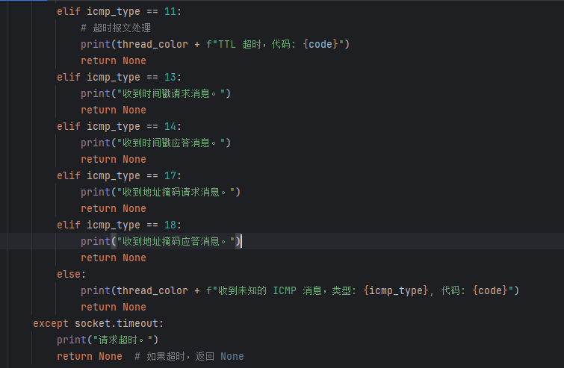
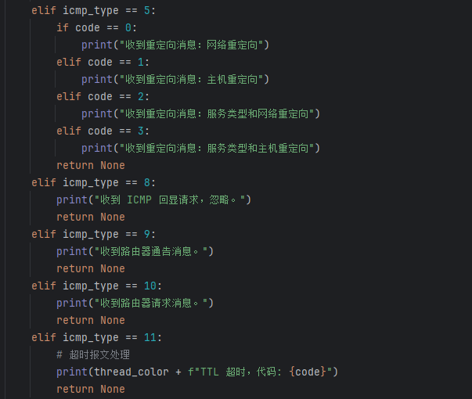
prepare
packet
process
test
conclusion
ICMP Type Handling
1. Type 0 - Echo Reply:
Confirms receipt of an Echo Reply (type 0).
Matches the ID to verify the packet corresponds to the sent request.
Checks user data for consistency to ensure data integrity.
2. Type 3 - Destination Unreachable:
Indicates that the target address is unreachable.
3. Type 5 - Redirect: Sent when there is a better route for the packet.
Codes 0-3 for different types of redirection:
Code 0: Network Redirect.
Code 1: Host Redirect.
Code 2: Type of Service and Network Redirect.
Code 3: Type of Service and Host Redirect.
Type 11 - Time Exceeded:
Sent when the packet's Time To Live (TTL) expires during routing.
Other Types: Types like 8 (Echo Request), 9 (Router Advertisement), 13 (Timestamp Request), etc., are also handled to cover different ICMP messages.
Unknown Type Handling: Outputs a message indicating receipt of an unrecognized ICMP type, displaying its type and code.
Timeout Handling: Captures socket.timeout exception and outputs "Request timed out" when no response is received within the defined timeout period.

Slide 15
prepare
packet
process
test
conclusion
do one ping & ping
create icmp packet
ping multiple addresses
send one ping
extra
checksum
------
ping
---
do one ping
animate (Real-time plotting)
functions
receive one ping
checksum
traceroute
Host A
Router A
Router B
Router C
Host B
id(unique)
Header
……
ICMP Echo Request
ICMP data packet
Socket
Data
Delay
ICMP Echo Reply

Slide 16
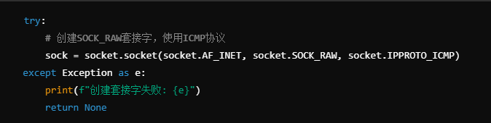

prepare
packet
process
test
conclusion
do one ping & ping
create icmp packet
ping multiple addresses
send one ping
extra
checksum
------
ping
---
do one ping
animate (Real-time plotting)
functions
receive one ping
checksum
traceroute
Host A
Router A
Router B
Router C
Host B
id(unique)
Header
……
ICMP Echo Request
ICMP data packet
Socket
Data
Delay
ICMP Echo Reply

Slide 17
prepare
packet
process
test
conclusion
do one ping & ping
create icmp packet
ping multiple addresses
send one ping
extra
checksum
------
ping
---
do one ping
animate (Real-time plotting)
functions
receive one ping
checksum
traceroute
Host A
Router A
Router B
Router C
Host B
id(unique)
Header
……
ICMP Echo Request
ICMP data packet
Socket
Data
Delay
ICMP Echo Reply

Slide 18
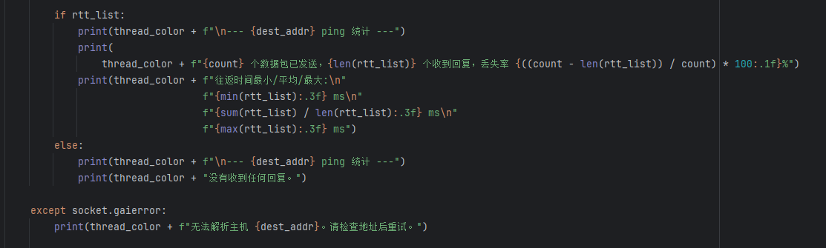
prepare
packet
process
test
conclusion
do one ping & ping& ping
create icmp packet
ping multiple addresses
send one ping
extra
checksum
------
ping
---
do one ping
animate (Real-time plotting)
functions
receive one ping
checksum
traceroute
Host A
Router A
Router B
Router C
Host B
id(unique)
Header
……
ICMP Echo Request
ICMP data packet
Socket
Data
Delay
ICMP Echo Reply

Slide 19
04
PART
Testing

Slide 20

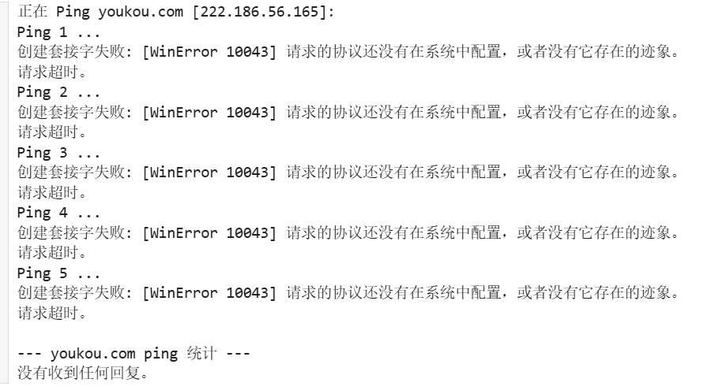
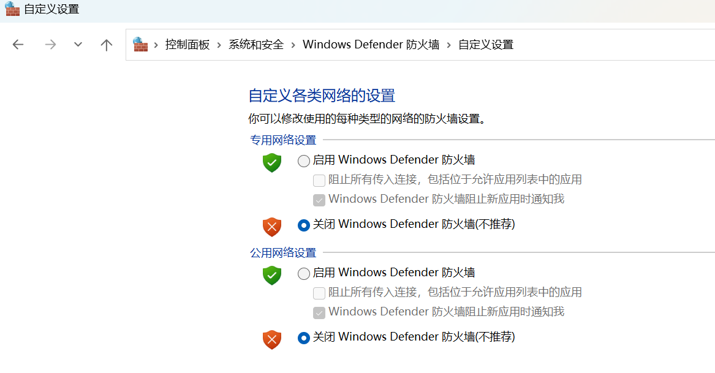
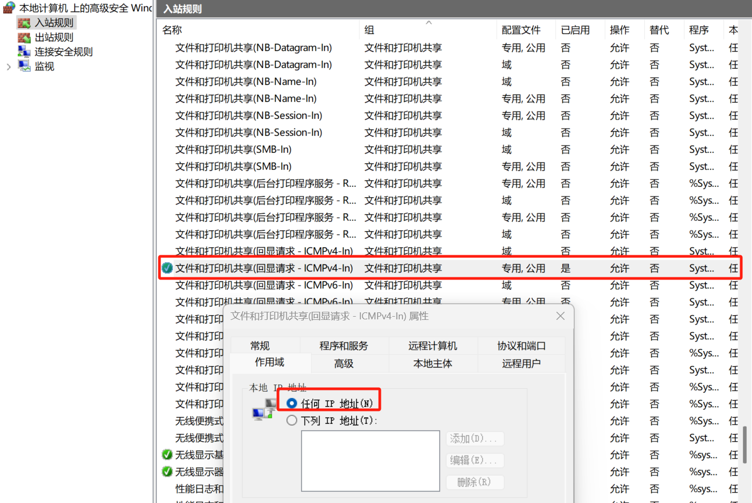
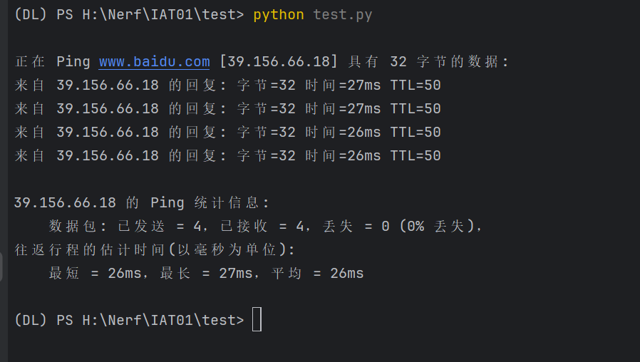
prepare
packet
process
test
conclusion
Multiple problems have been solved
1. Unable to ping locally:
:
Possible Solution:
Disable Defender
Change the inbound rules
Tips: In some PCs, you need to add the www. prefix

Slide 21
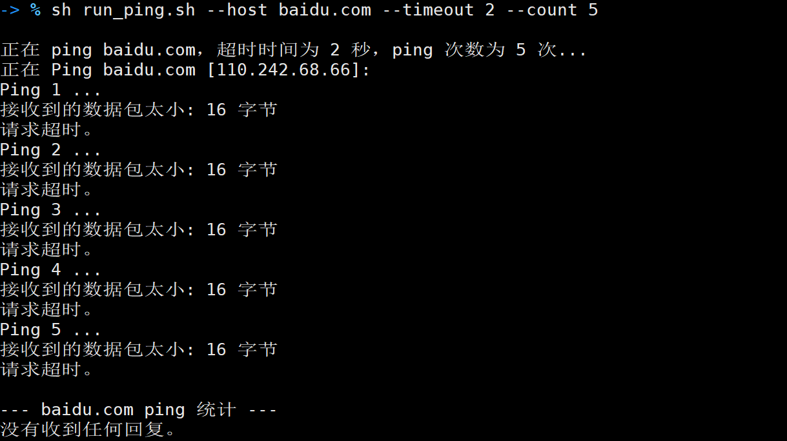
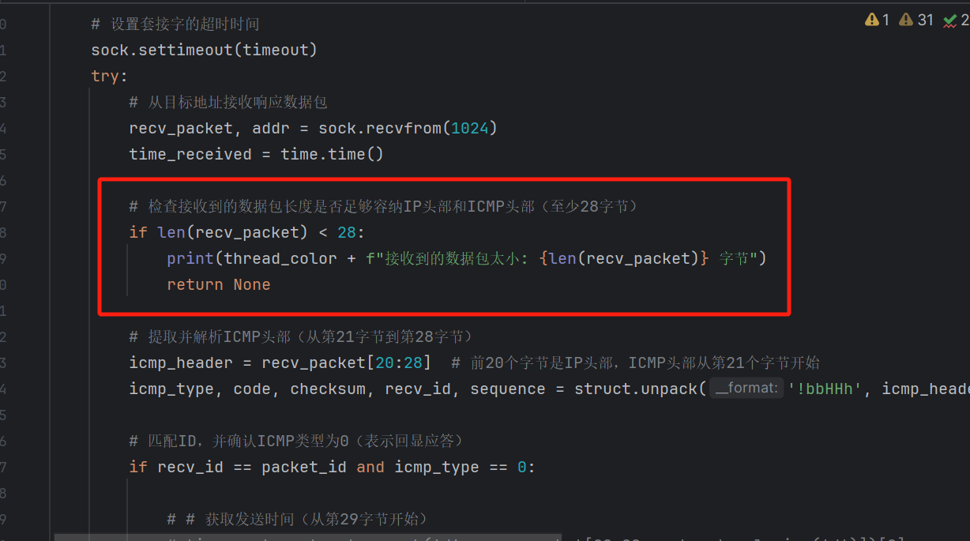
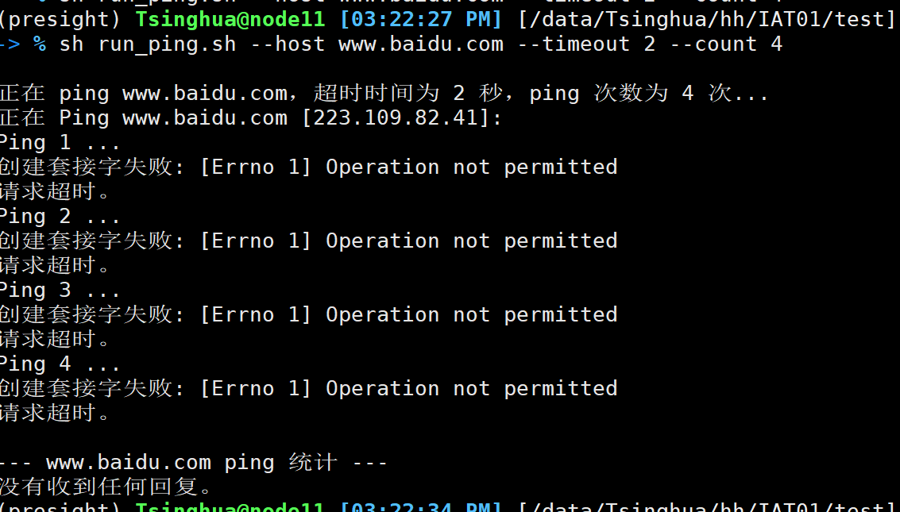
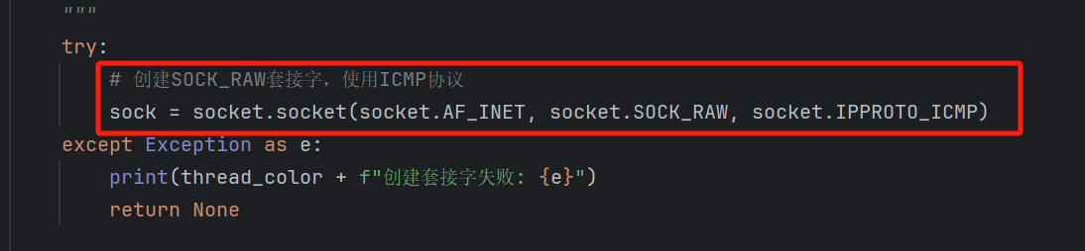
prepare
packet
process
test
conclusion
Multiple problems have been solved
2. Try to ping on a linux server:
Possible Solution:
Use the .sh script on the server
Maybe I need to change the socket type?
Change SOCK.DGRAM to SOCK.RAW
SOCK.RAW: You need to have root privileges

Slide 22
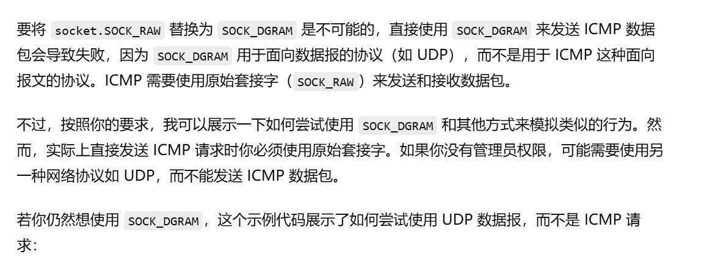
prepare
packet
process
test
conclusion
Multiple problems have been solved
3. SOCK.DGRAM vs SOCK.RAW:
Possible Solution:
Still use windows but not linux
Still use the SOCK.RAW
They apply to different network protocols
Tips: In some PCs, I need to run the program as an administrator

Slide 23
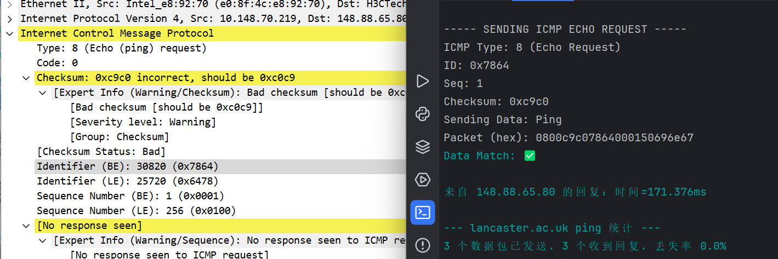
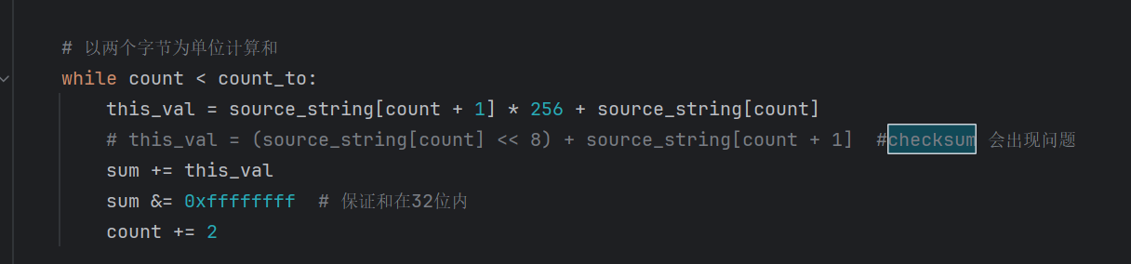
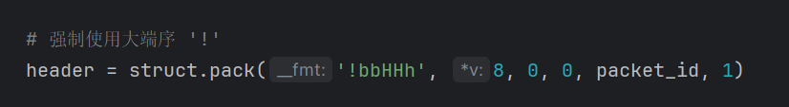
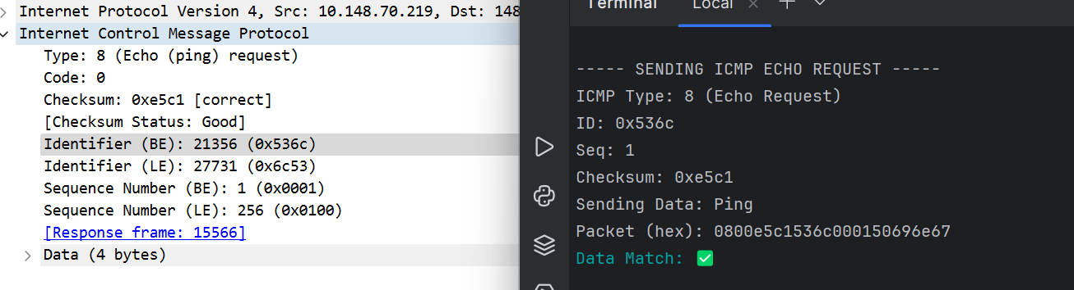
prepare
packet
process
test
conclusion
Multiple problems have been solved
4. WireShark to test:
Possible Solution:

Slide 24
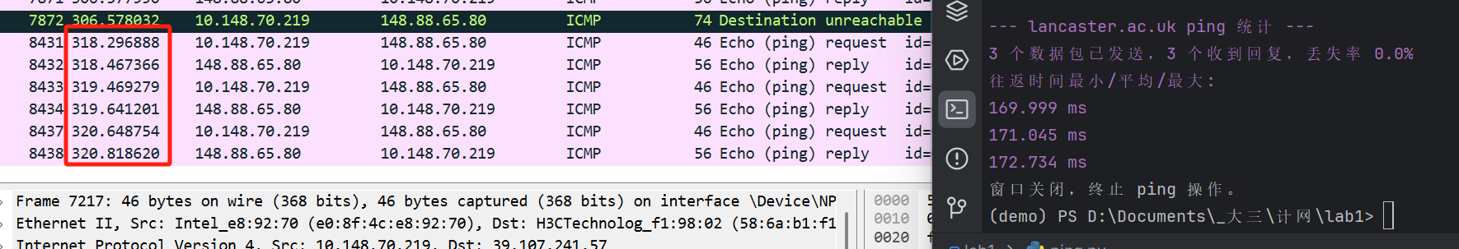
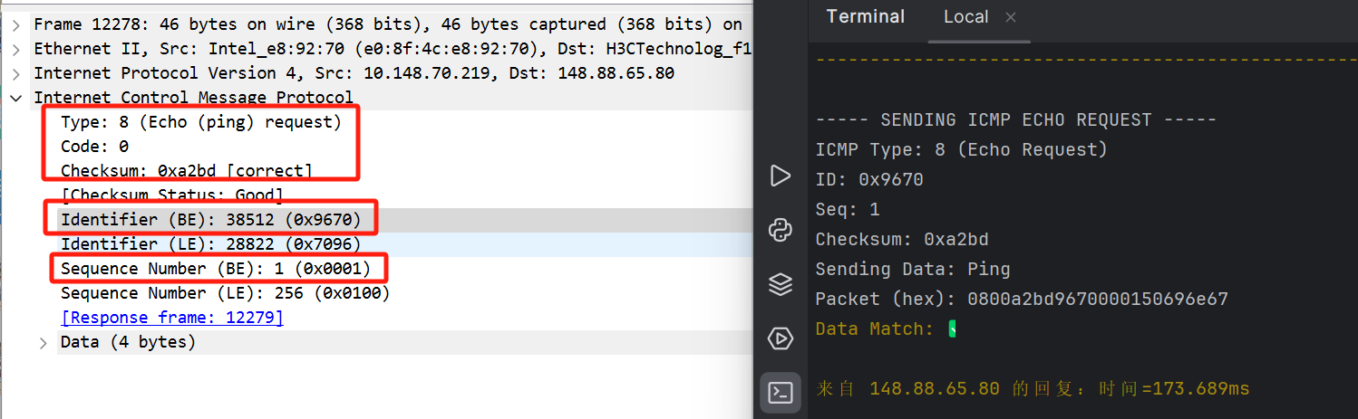
prepare
packet
process
test
conclusion
Multiple problems have been solved
4. WireShark to test:

Slide 25
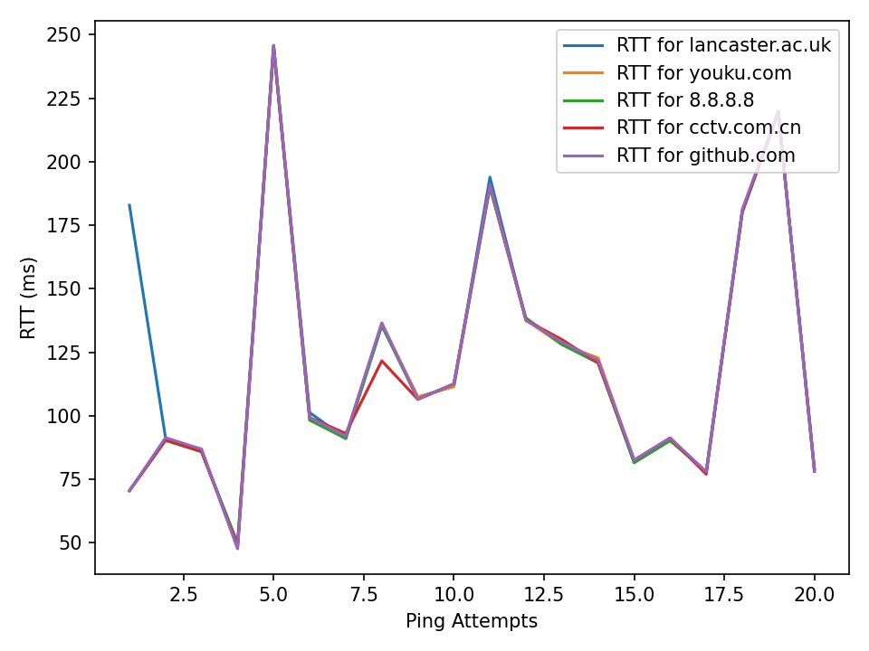
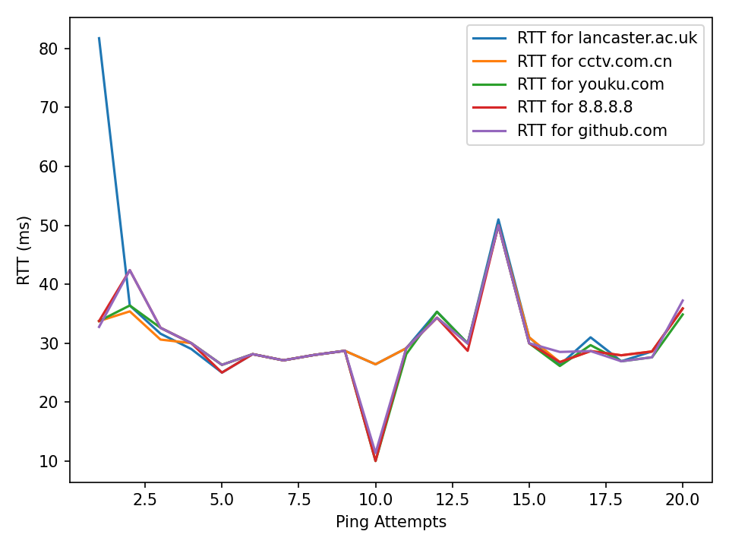
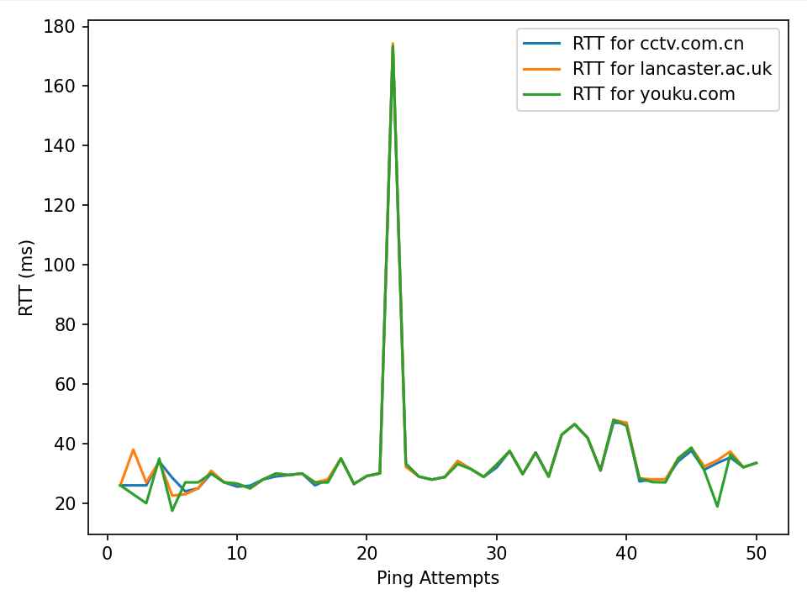
prepare
packet
process
test
conclusion
Multiple problems have been solved
5. Test delay in different time:
Test time: 9pm
Test time: 21 pm
Network fluctuations can be found
Network delay is higher in the morning than in the evening
Lancaster.ac.uk has the highest average delay on the web

Slide 26
05
PART
Conclusion

Slide 27

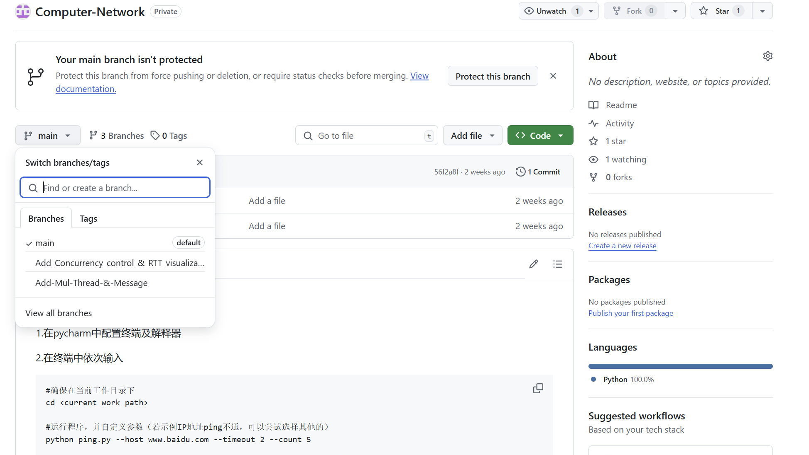
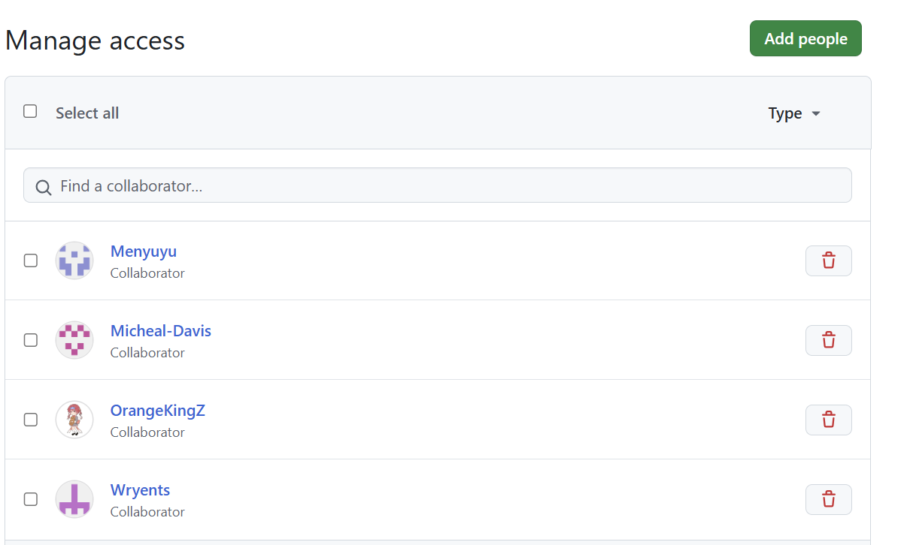
prepare
packet
process
test
conclusion
Version control: Using Github
README.md
ping.py
.sh script
3 branches
5 collaborators

Slide 28
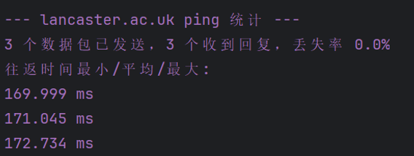
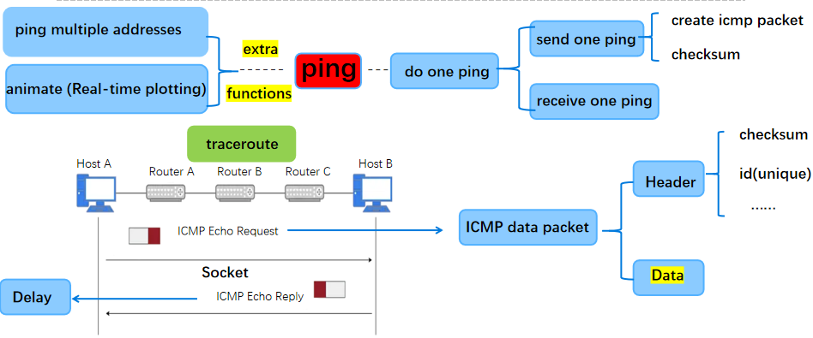
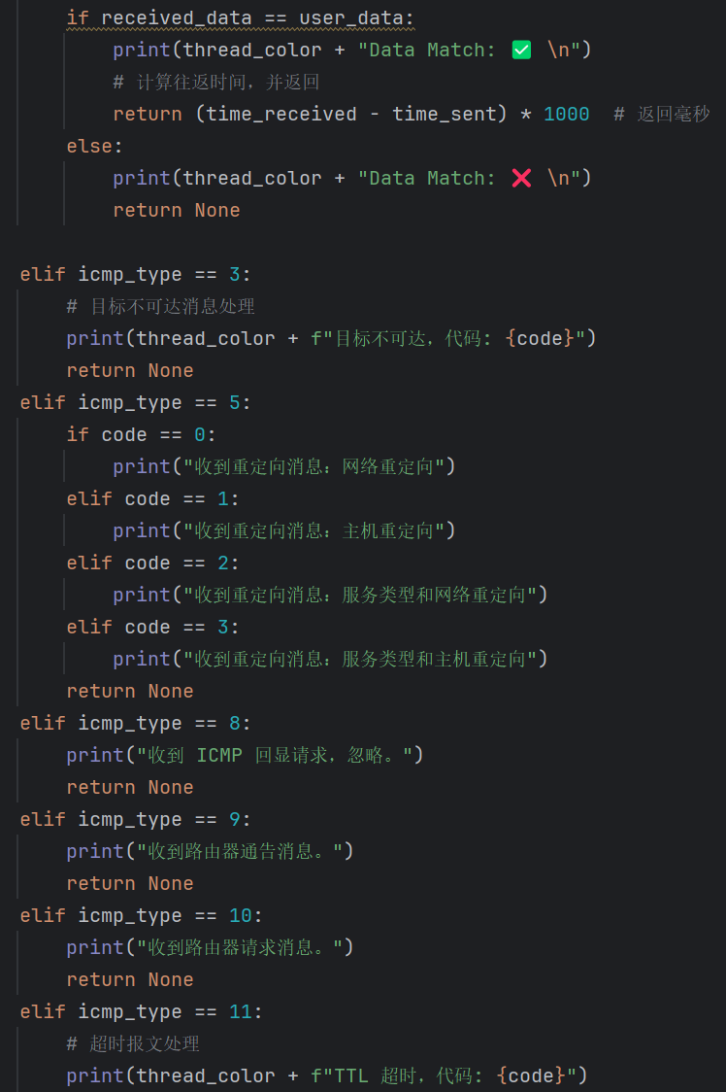
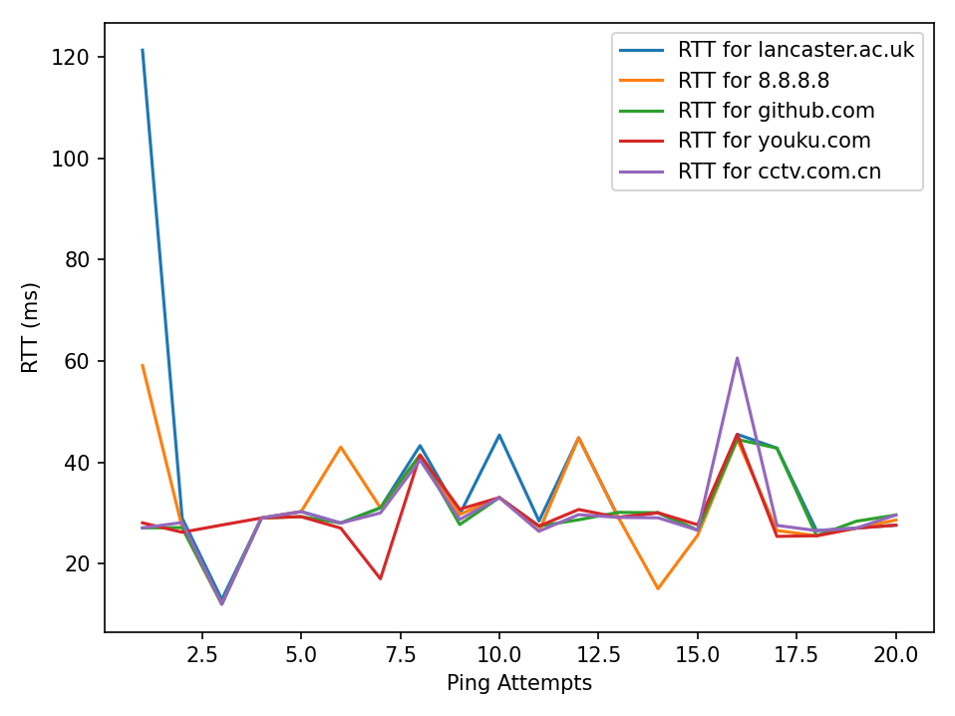
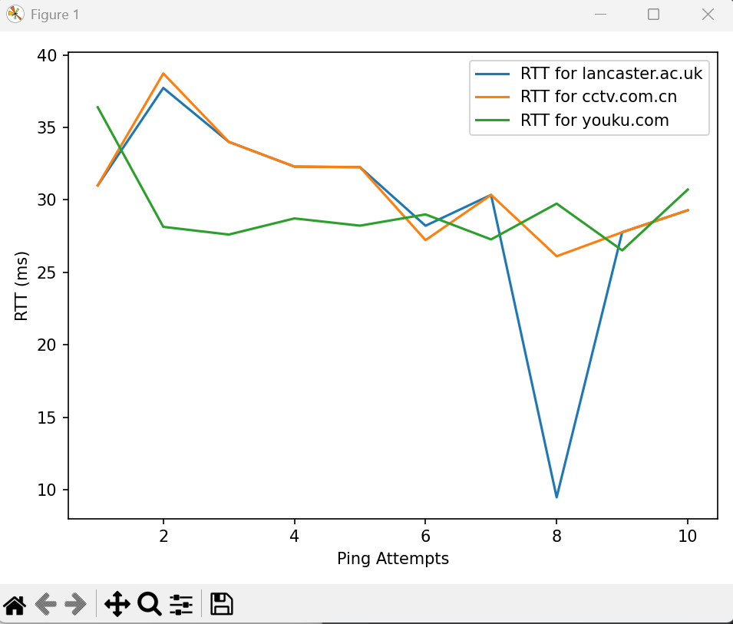
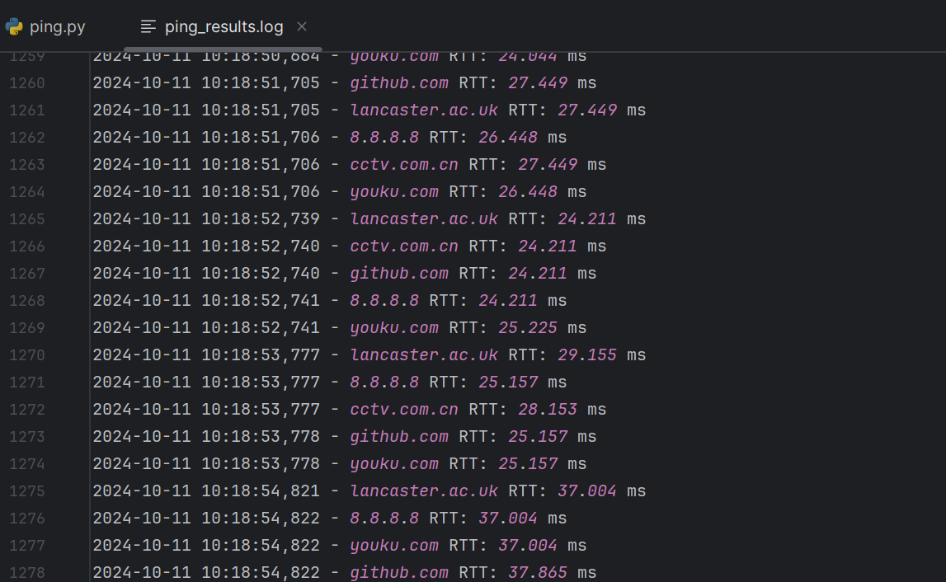
prepare
packet
process
test
conclusion
Summary of all functional implementations
Caculation of delay(min/max/avg)
Calculation of packet loss rate
20 kinds of exception handling
5 user input parameters
Customize packet sending content
Multithreading and concurrent processing
(Multi-destination ip management)
RTT visualization
log storage

Slide 29
Thank you!
Huang Hao, Zhou Yitong, Meng Yu, Chen Zijie, Wen Tianshu
2024.10.11

